Slide 1
High Bandwitdh Servo Motor Drive Design for High Precision Position Control Applications
Hüseyİn YÜRÜK
TİK DECEMBER 2018

Slide 2
Outline
problem definition
motivation
experimental works
future plan

Slide 3
problem definition
following nonlinearities cause distortion on the output voltage of the VSI
dead-time
switching time
delay time
voltage drops on the power switch
parasitic capacitance of the power switch

Slide 4
problem definition
output voltage distortion causes
low order harmonic components in the output current of the inverter
deformation of the phase currents, especially in the current zero-crossing region
these distortions
effects the control performance of the applications that require low speed & low torque
degrades the efficiency and increases the torque ripple
As the switching frequency increases effect of
dead-time
switching time
delay time
will also increases.
But, to get high current control bandwidth, higher switching frequency is needed, especially to control low inductance motors

Slide 5
motivation
High performance VSI-fed PMSM motor drive can be achieved by having high current control bandwidth where effect of the VSI nonlinearities are reduced
High performance VSI-fed PMSM motor drive will be more crucial for the applications which have the following properties:
low magnitude dc link
low torque
low inductance machine
high precision position control
for ex. gimbal applications (rf, optic etc.), robot arm, optic stabilizer, CNC machines, active vibration canceller etc.

Slide 6
Experimental works
analysis demonstrates that the nonlinear effects mainly produce 5th and 7th harmonics in the α-β reference frame and 6th voltage harmonic and its multiples in the d-q reference frame which cause current harmonics
to observe current harmonics in the phase current and also in the d-q reference frame currents, an air cored (ironless winding) low inductance motor is driven by MOSFET based PWM VSI inverter at open loop

Slide 7
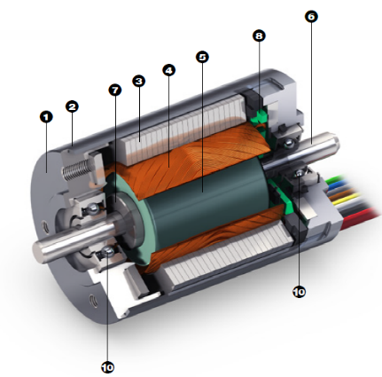
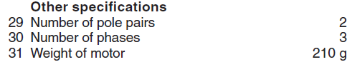
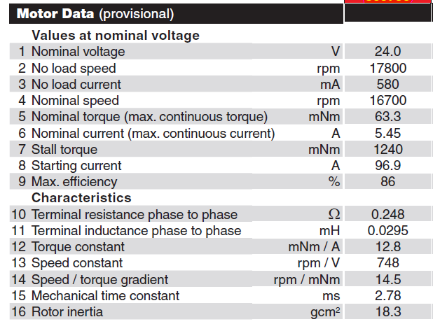
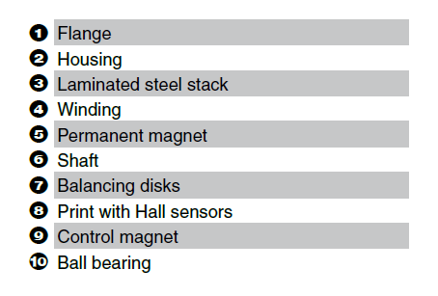
Experimental works
motor parameters

Slide 8
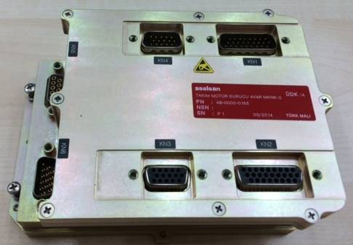
Experimental works
MOSFET based PWM VSI inverter parameters:
AVAR servo driver (REHİS-MMTM design)
Input voltage 18-50VDC
5Arms output current
Resolver, QEP, Hall, Abs Encoder feedback
CAN, RS422, Ethernet communication
ΔΣ phase current sensing
MOSFET (SUM90N10), gate driver (IRS2336D)
TMS320F28235 DSP

Slide 9
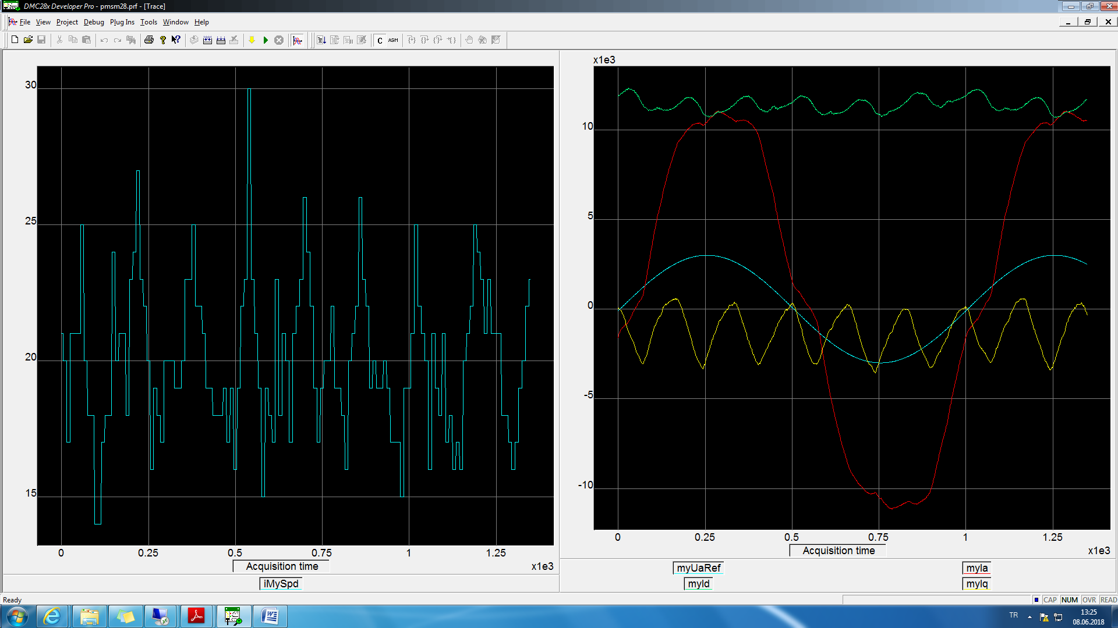
Experimental works
left figure motor speed, right figure blue phaseA pwm reference, red phaseA, green Id, yellow Iq current @10Hz speed @open loop

Slide 10
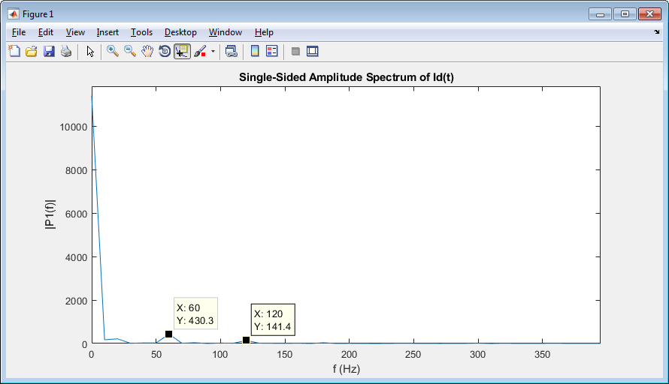
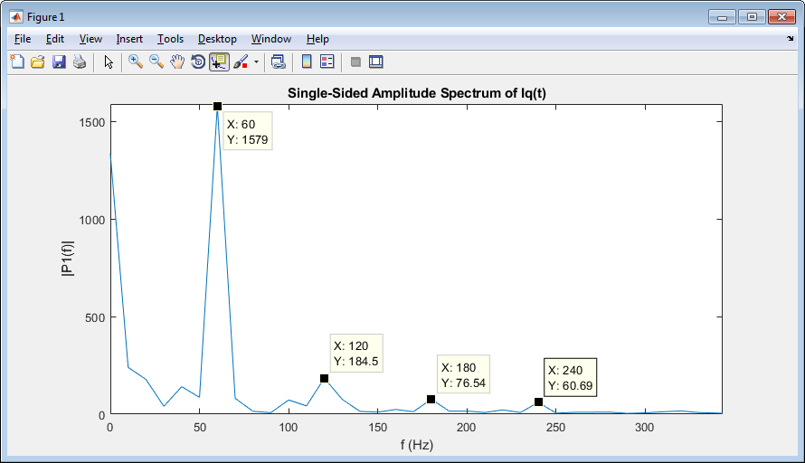
Experimental works
Id & Iq current, FFT analysis @10Hz speed @open loop

Slide 11
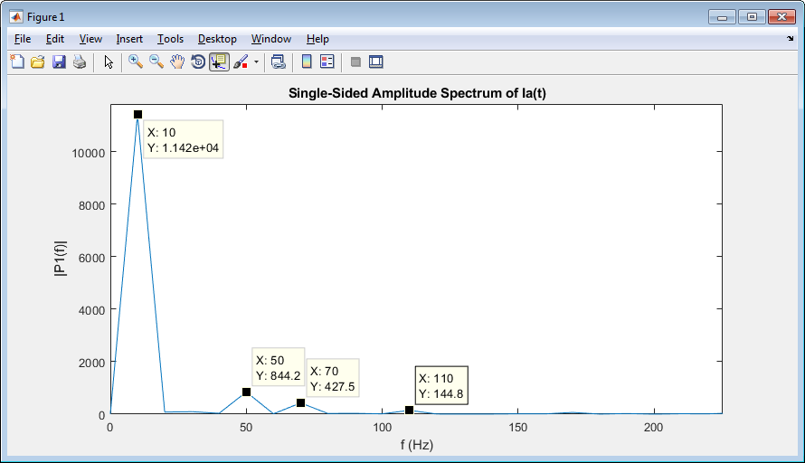
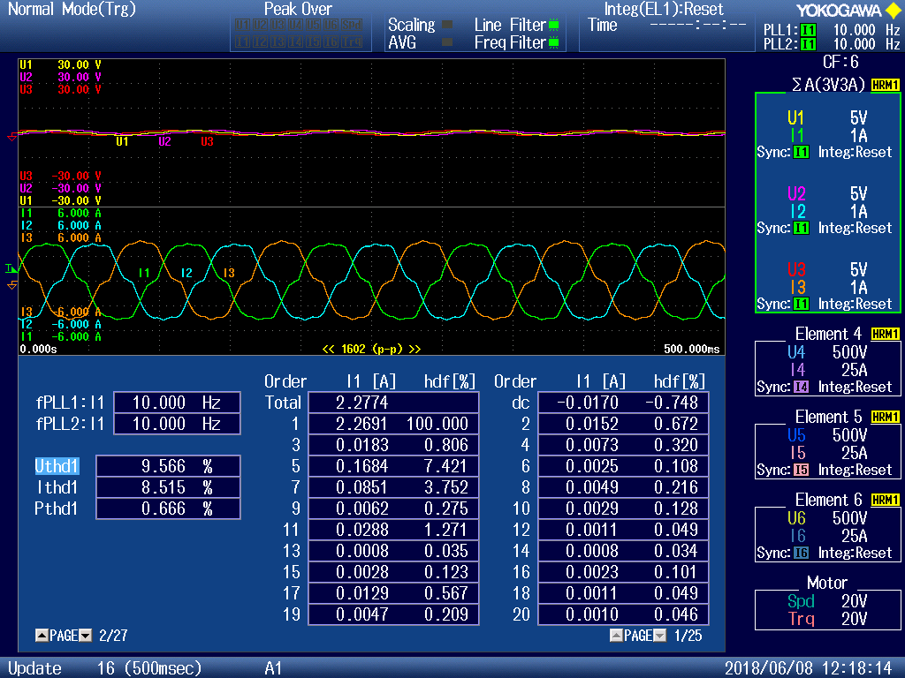
Experimental works
phaseA current, FFT analysis @10Hz speed @open loop
phase voltage and currents, and current harmonic distortions @10Hz speed @open loop

Slide 12
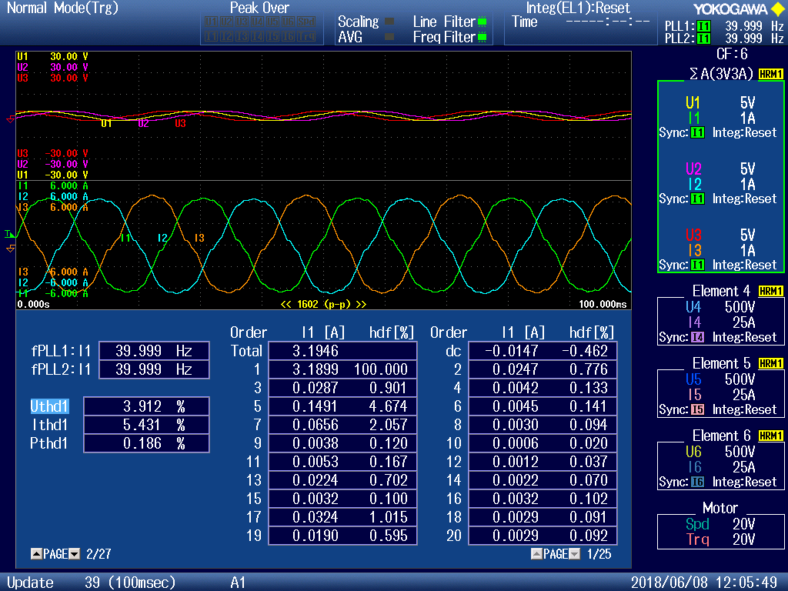
Experimental works
As the output frequency increases i.e. speed increases, current distortion decreases which can be seen below figure. (Ithd1 is decreased)
phase voltage and currents, and current harmonic distortions @40Hz speed @open loop

Slide 13
Experimental works
to observe effects of switching frequency on the nonlinearity, regular PI current control is used
to eliminate effect of the back emf voltage, iq_ref is given zero
to eliminate Ls effect, id_ref is varied so slow then only remains Rs value
especially at zero crossing regions of id current, nonlinearities effect more dominant
as the switching frequency increases, nonlinearities get more severe as can be seen below id and Ud figures.

Slide 14
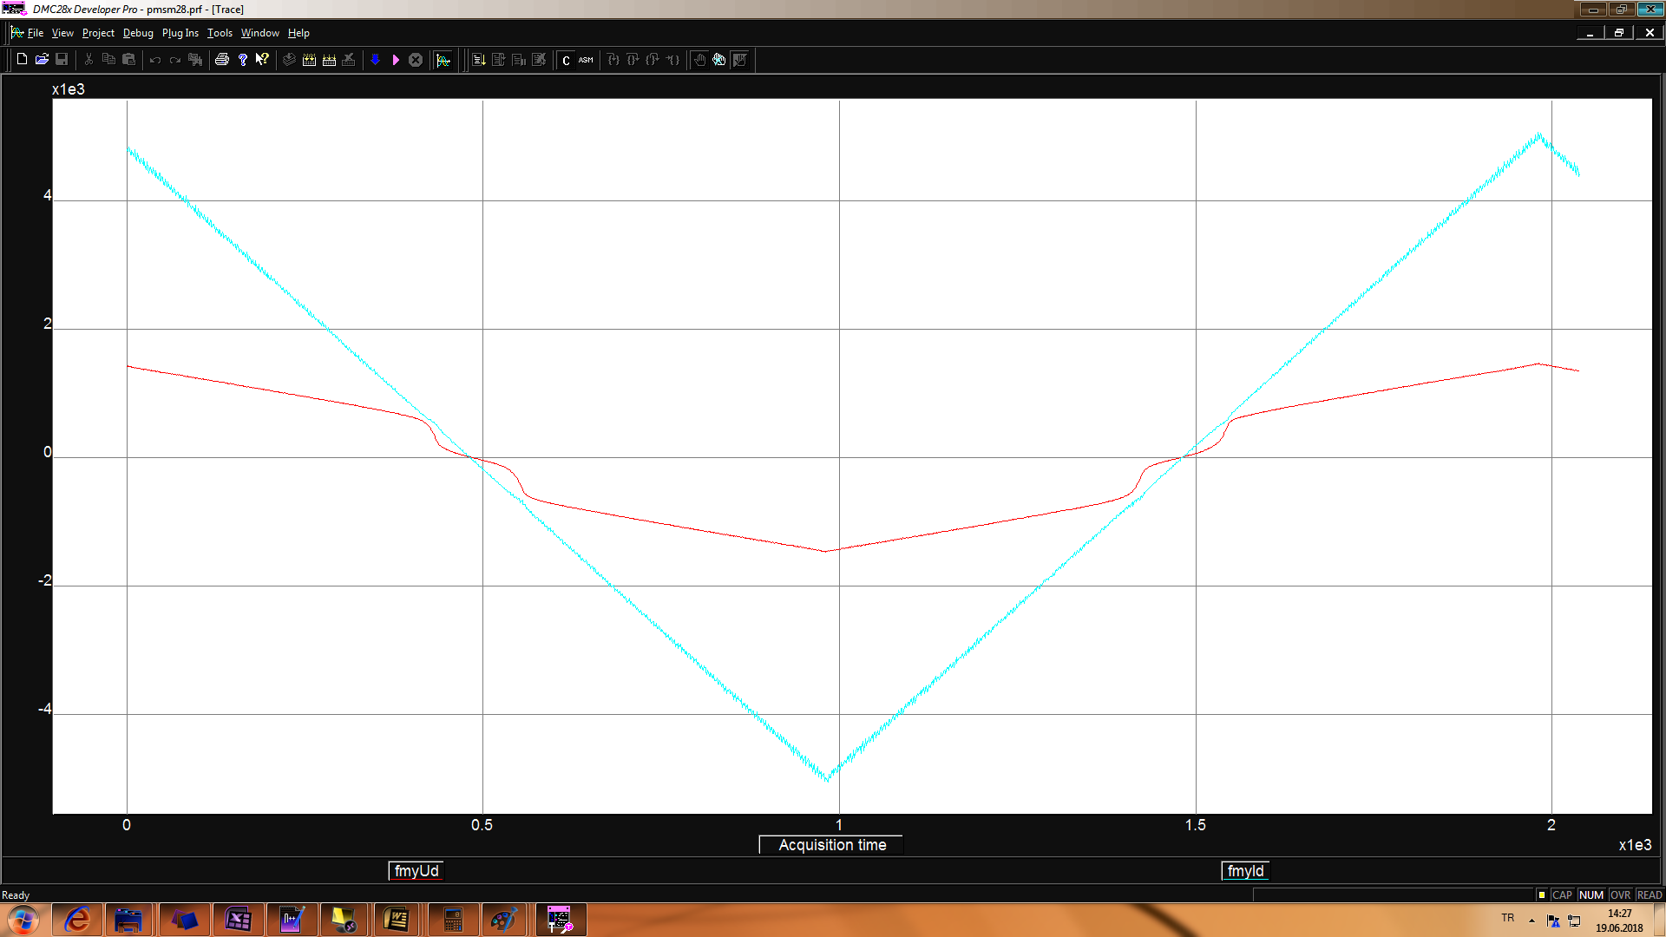
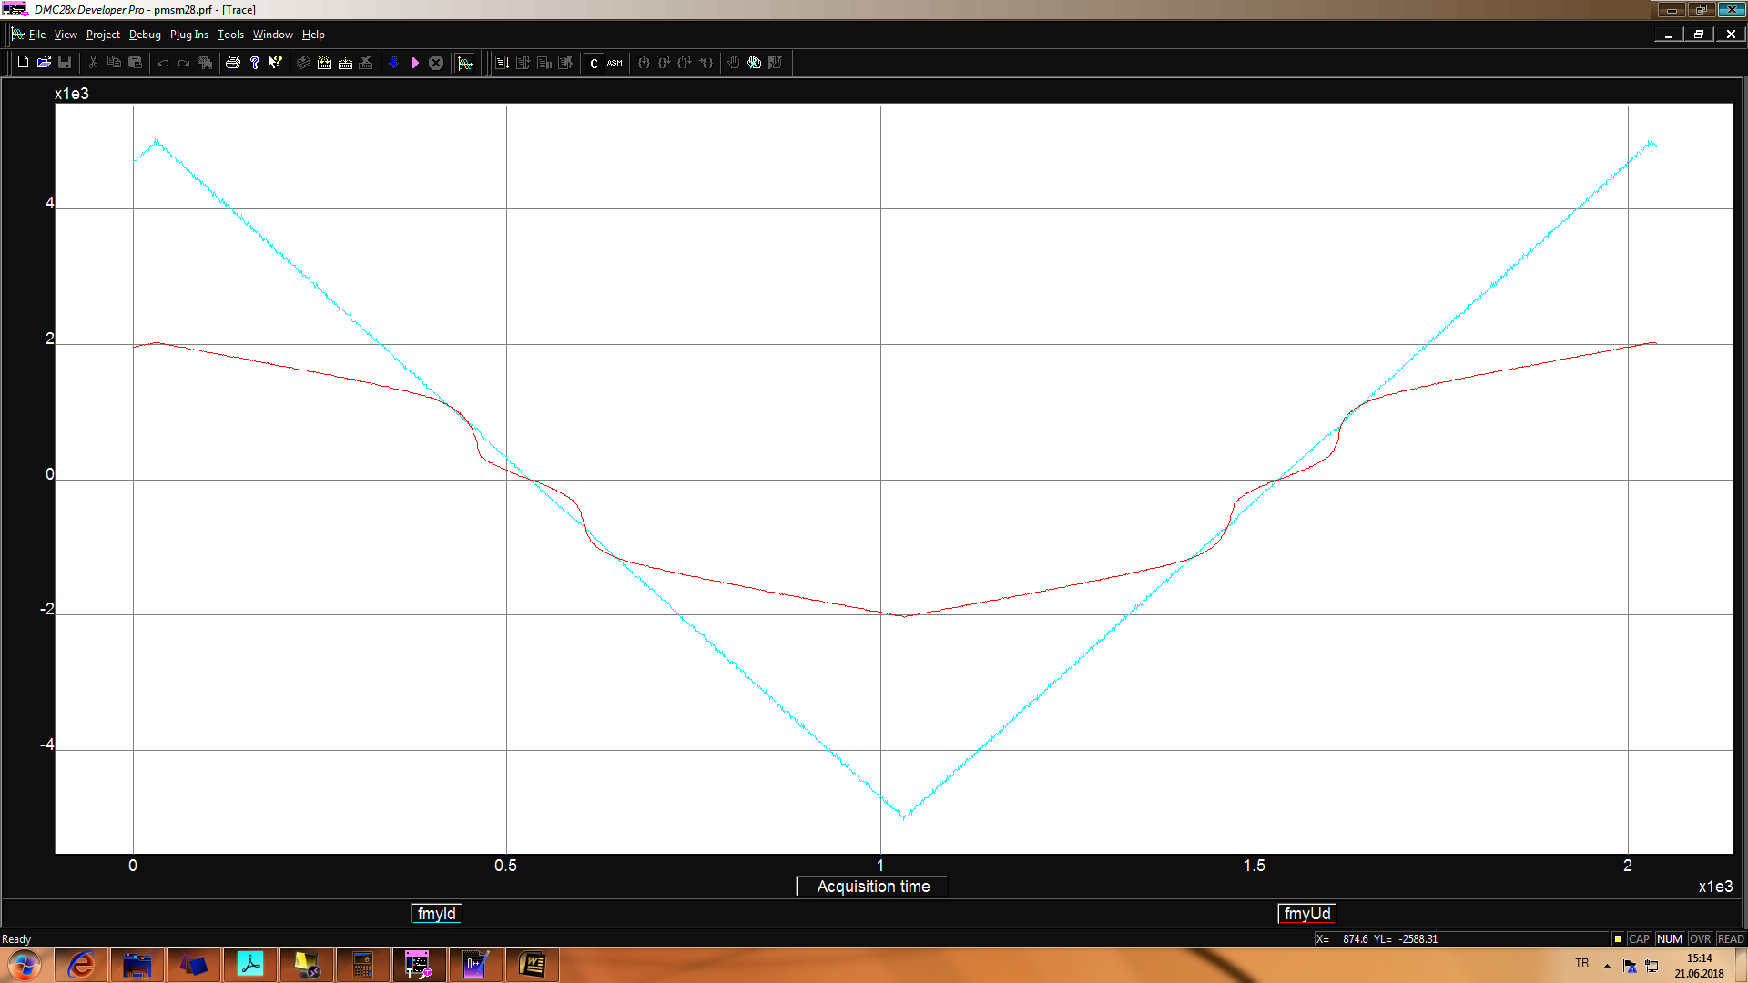
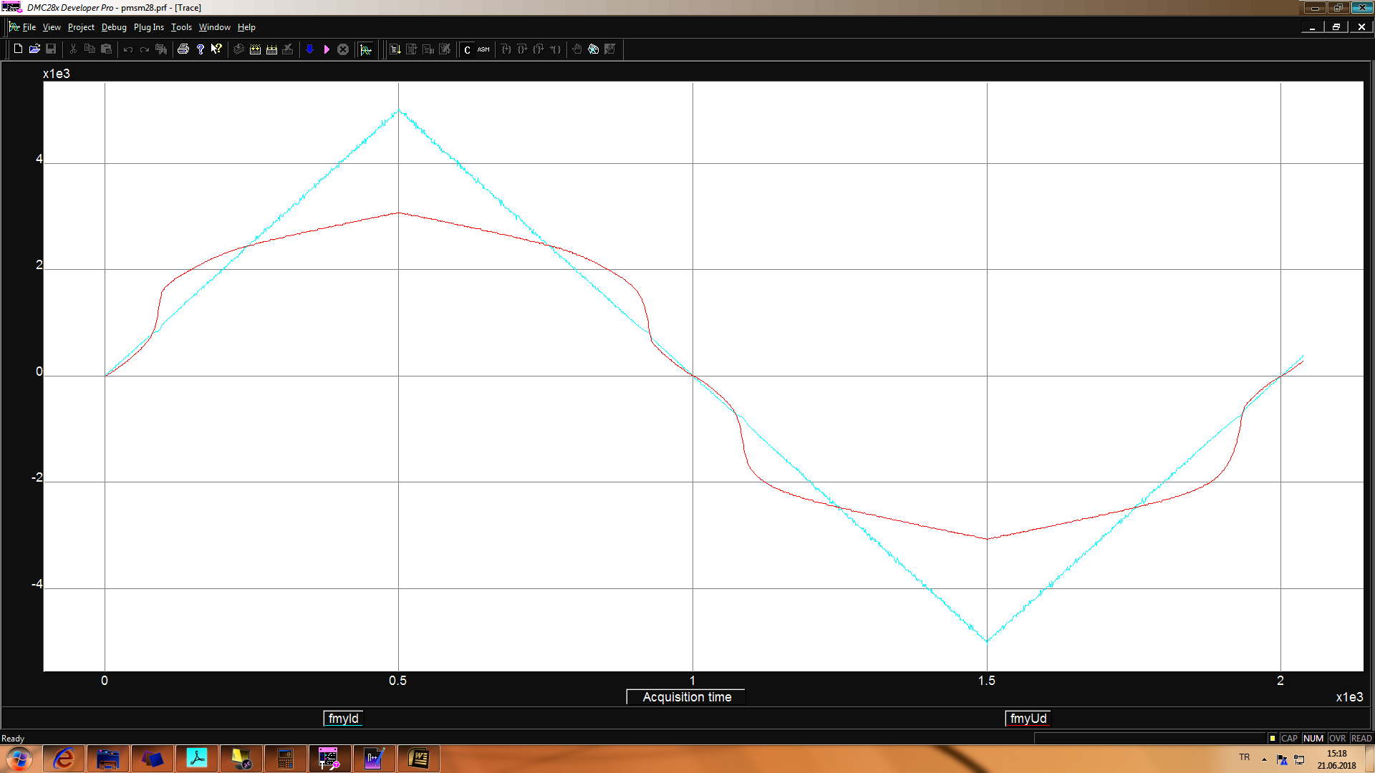
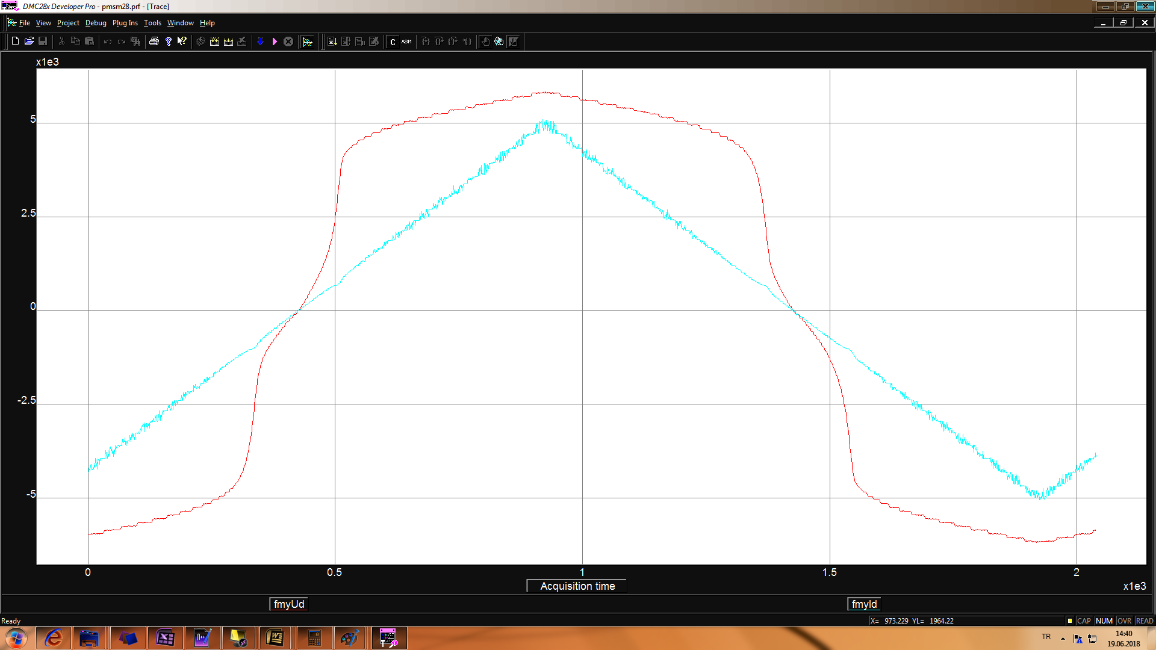
Experimental works
Fsw 10kHz
Fsw 20kHz
blue Id current and red Ud voltage
Fsw 40kHz
Fsw 100kHz

Slide 15
Experimental works
to find function of id f(id), the measured Id & Ud values are used which are taken at 20kHz switching frequency
Id & Ud graphs @fsw=20kHz @current loop

Slide 16
Experimental works
Ud vs Id graph is separated into pieces of parts, and curve fitting is applied to each parts to find f(id)
Id & Ud graph, pieces of parts @fsw=20kHz @current loop
Id & Ud graph, fitted curves @fsw=20kHz @current loop

Slide 17
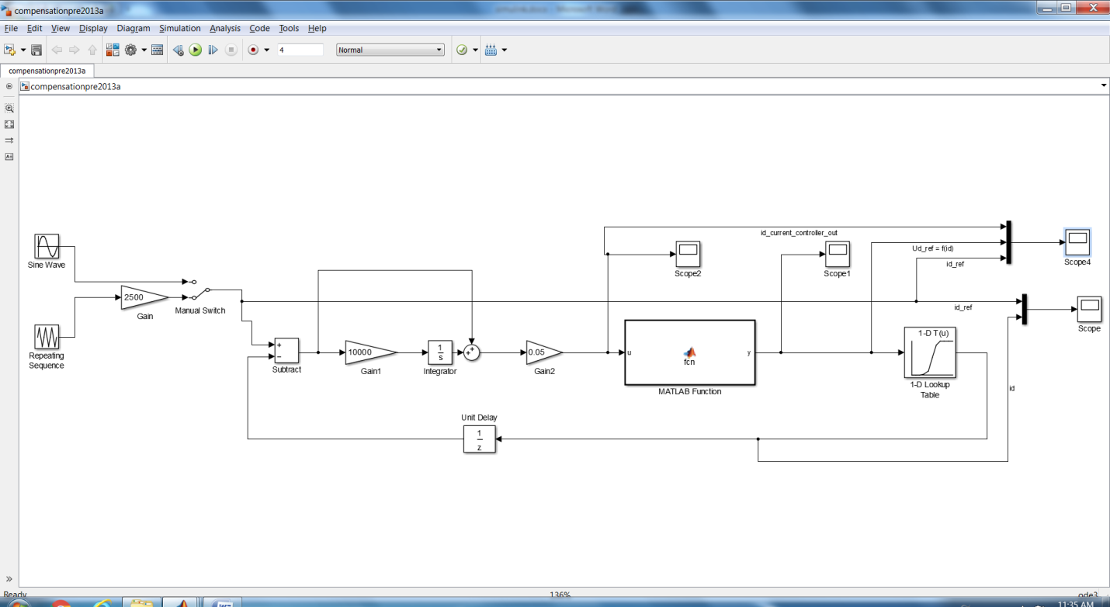
Experimental works
If nonlinearity is compensated by using f(id) to get Ud voltage, id controller output will see only Rs
simulink model, nonlinearity is compensated by using f(id)

Slide 18
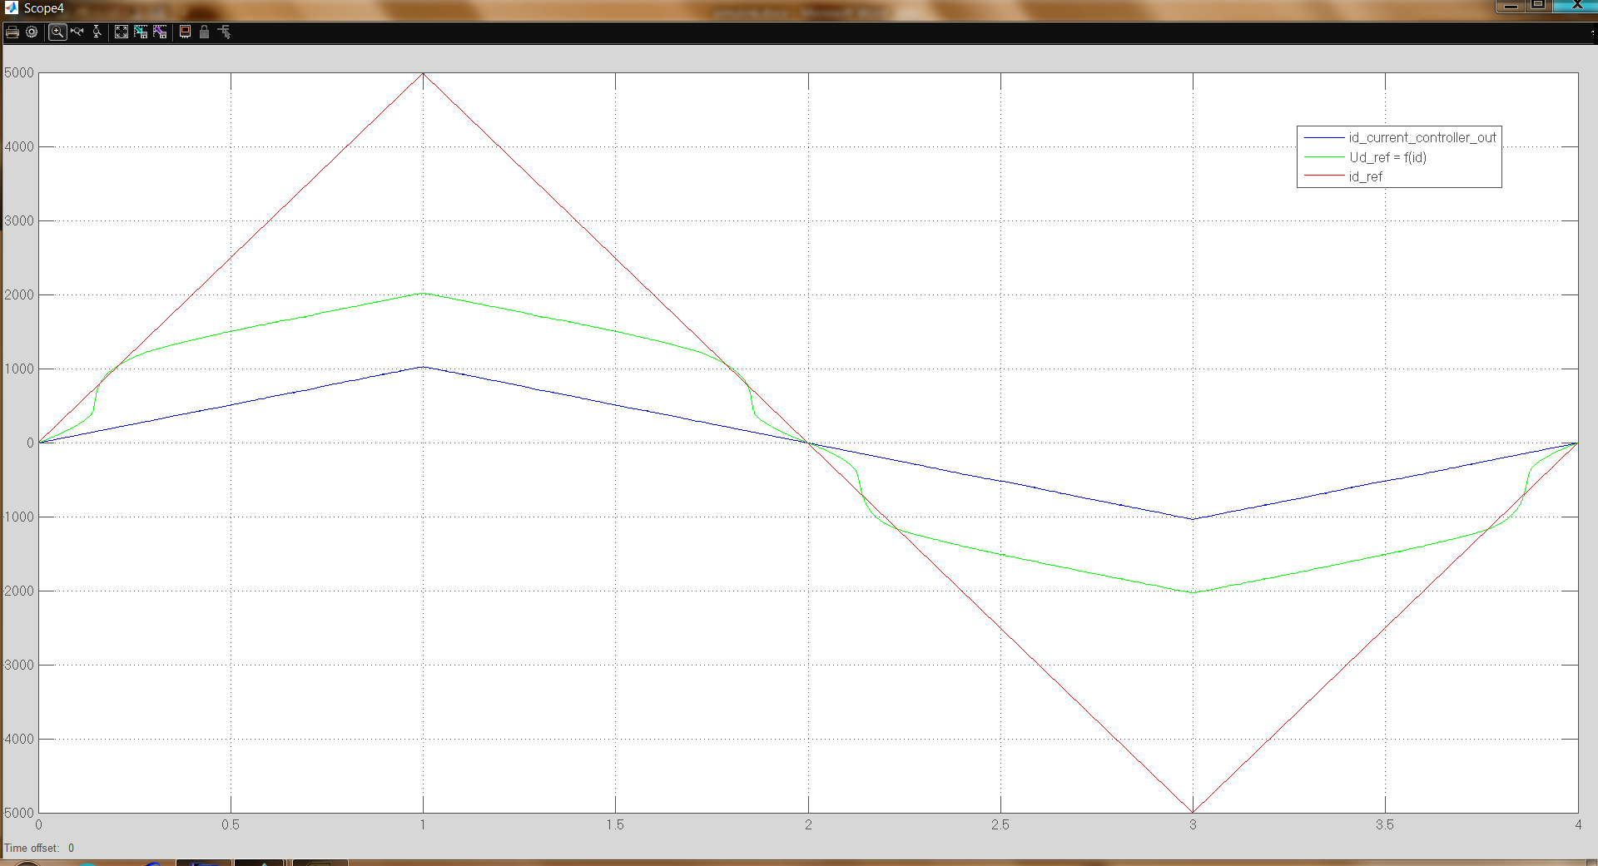
Experimental works
simulation data, red id_ref, green f(id), blue id controller output, nonlinearity is compensated by using f(id)

Slide 19
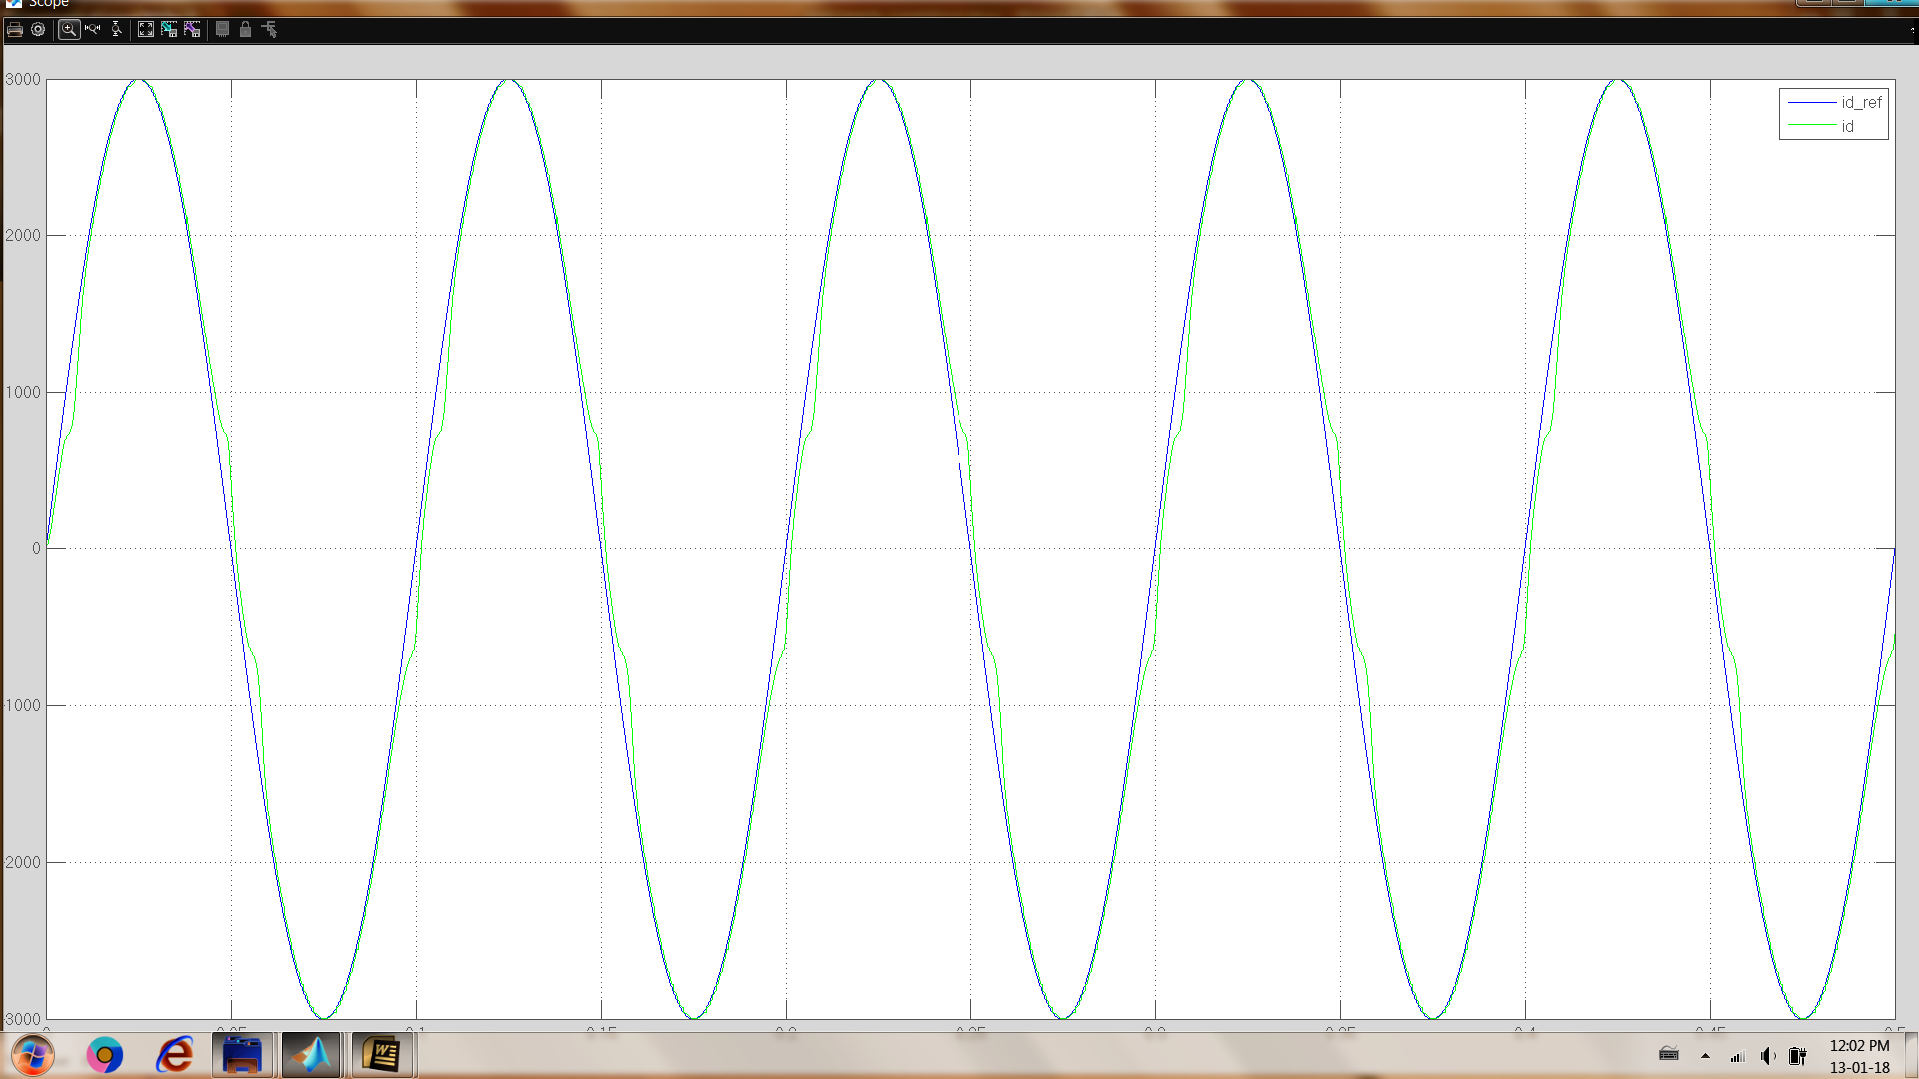

Experimental works
simulation data, blue id_ref, green id, nonlinearity is not compensated, 10hz sine wave id_ref
simulation data, blue id_ref, green id, nonlinearity is compensated, 10hz sine wave id_ref
Notes:
simulation data, blue id_ref, green id, nonlinearity is not compensated, 10hz sine wave id_ref

Slide 20
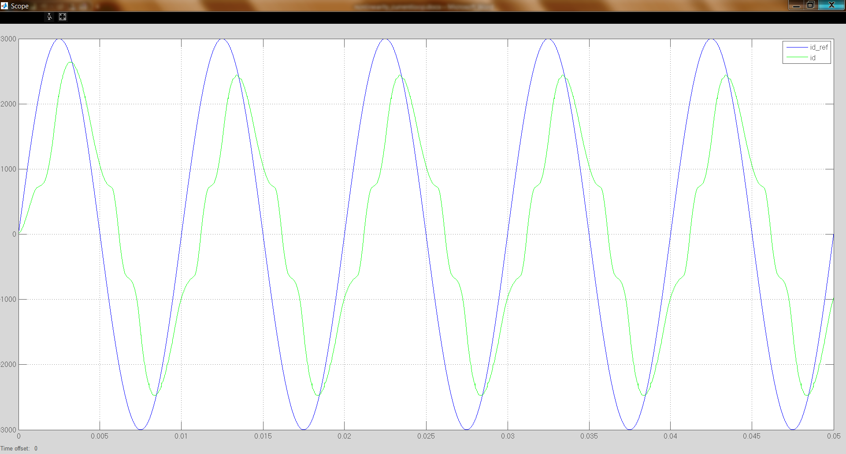
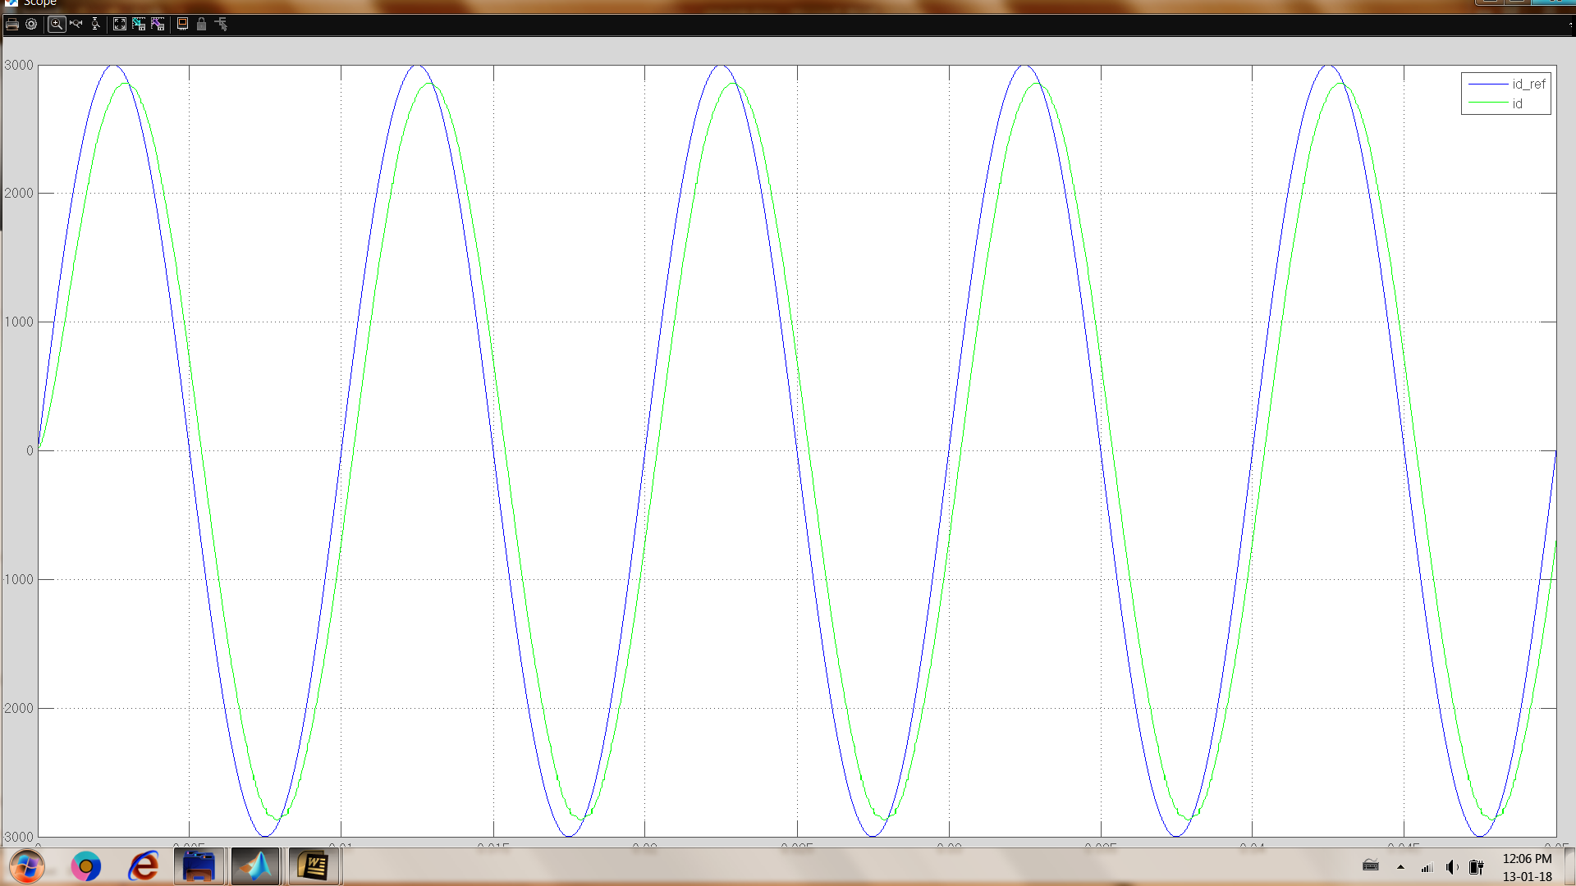
Experimental works
simulation data, blue id_ref, green id, nonlinearity is not compensated, 100hz sine wave id_ref
simulation data, blue id_ref, green id, nonlinearity is compensated, 100hz sine wave id_ref
Notes:
simulation data, blue id_ref, green id, nonlinearity is not compensated, 10hz sine wave id_ref

Slide 21
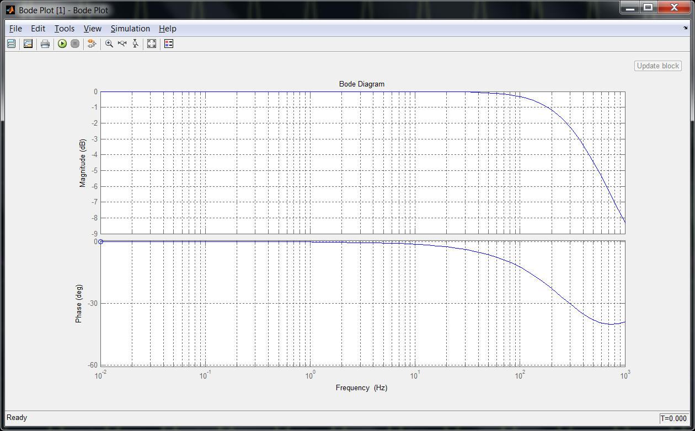
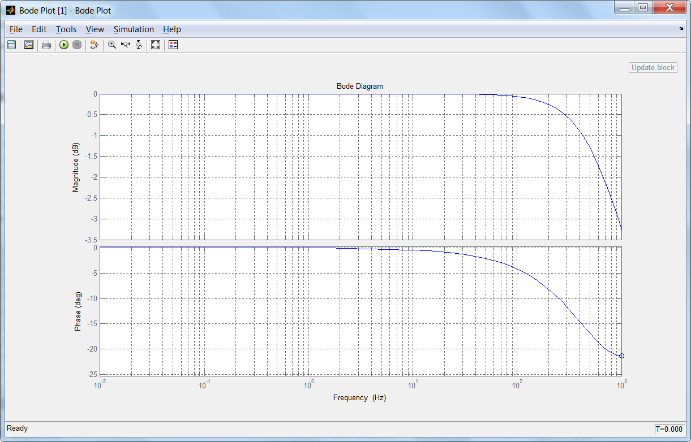
Experimental works
with compensation, bandwidth of the current controller is also increases as can be seen below bode diagrams
bode diagram of current controller, without nonlinearity compensation
bode diagram of current controller, with nonlinearity compensation

Slide 22
Experimental works
similar tests are repeated by experimentally
experimental data, orange id_ref, red id, nonlinearity is uncompensated, 10hz sine wave id_ref
experimental data, orange id_ref, red id, blue f(id) nonlinearity is compensated, 10hz sine wave id_ref

Slide 23
Experimental works
experimental data, orange id_ref, red id, nonlinearity is uncompensated, 100hz sine wave id_ref
experimental data, orange id_ref, red id, blue f(id) nonlinearity is compensated, 100hz sine wave id_ref

Slide 24
Experimental works
difficulties to get f(id) for compensating nonlinearities
one of the piece of parts red measured data, only fractions different between blue and yellow fitted curves
blue 1ms per sample, green 0.5ms per sample, Id vs Ud graphs with different sample rates
Id vs Ud graphs with different input voltage values

Slide 25
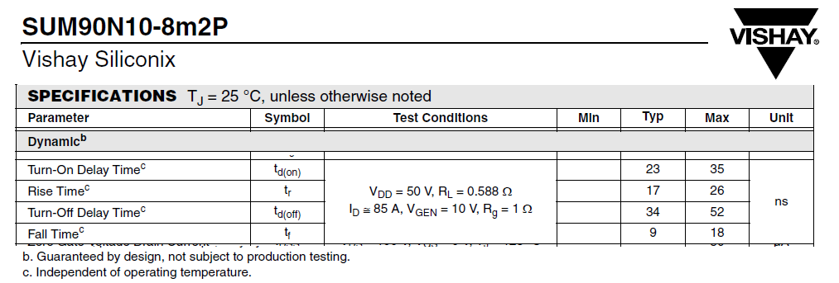
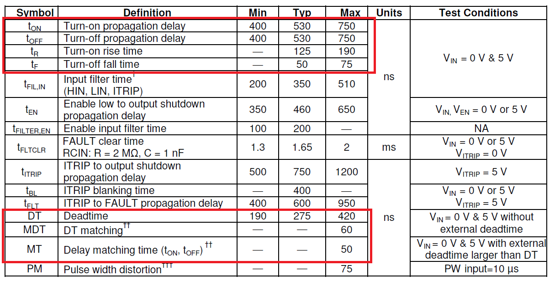
Experimental works
dead-time
for this MOSFET based VSI, dead-time is configured to 1.0us
rise/fall time of the mosfet/gate driver
turn on/off delay time of the mosfet/gate driver
are the most dominant terms in the nonlinearity
MOSFET SUM90N10 time specs
irs2336D time specs

Slide 26
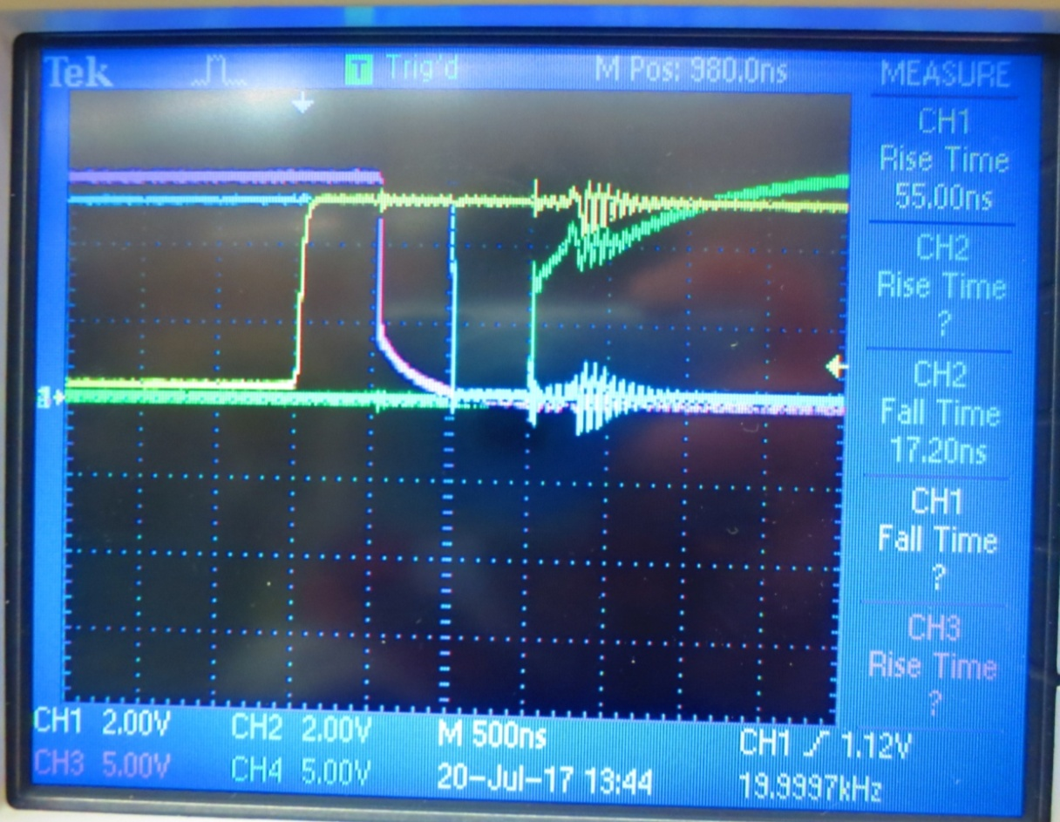
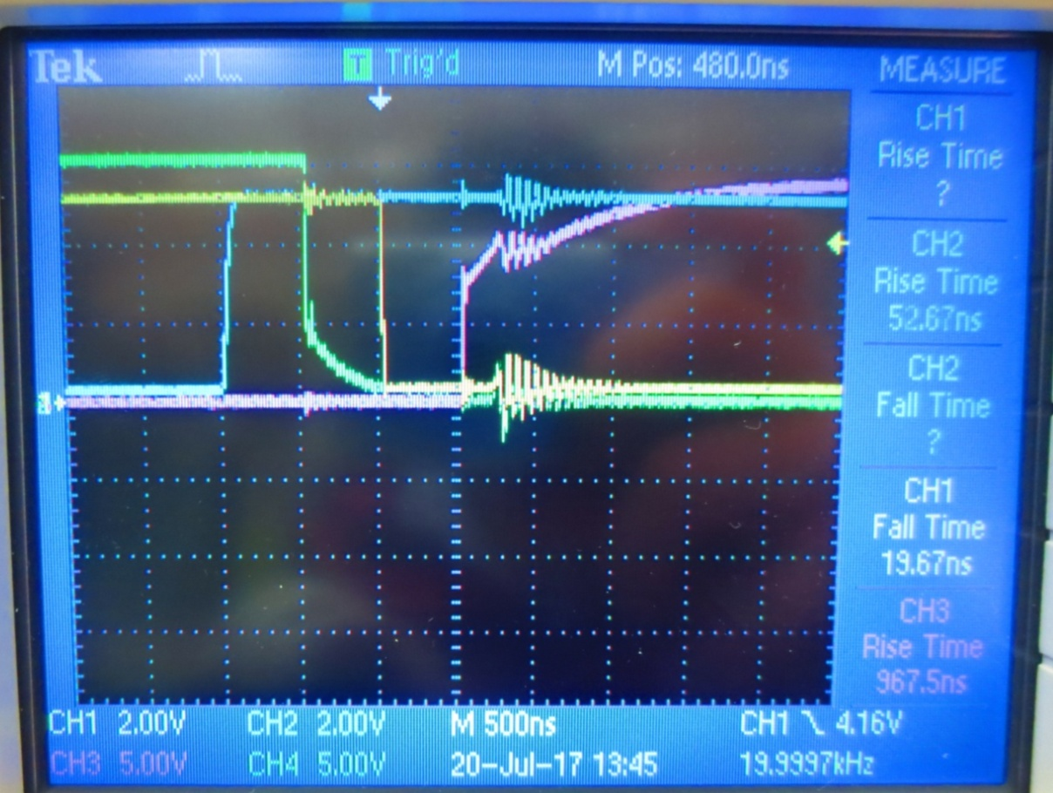
Experimental works
yellow PWMA_VinHI, blue PWMB_VinLO (gate driver inputs), pink Gate_driver_OUTA_HI, green gate_driver_OUTB_LO, irs2236(D) active low

Slide 27
Experimental works
Effect of these time parameters get more dominant as the switching frequency increases
For example dead-time 1us is the 1% of the switching period when fsw 10kHz, but it is 10% when fsw 100kHz
Although these nonlinearity may be compensated by determining f(id) functions to increase bandwidth of the current controller, it is difficult to obtain valid f(id) for all input voltages, for all environmental conditions etc.
So, if a GaN transistor based VSI is used instead of the MOSFET based VSI, these time parameter values will decreases. So effect of these parameters on nonlinearity will also decreases

Slide 28
Experimental works
wide-bandgap (WBG) devices, such as GaN HEMTs and SiC MOSFETs are recently growing interest for the power electronics design
compared to conventional Si MOSFETs or IGBTs, WBG devices exhibit shorter turn on/off time intervals, close-to-zero reverse recovery loss, better thermal capability and smaller conduction loss
these characteristics make it possible to increase the system switching frequency from ~hundreds of kHz to >MHz, which further results in the significant weight and size reduction of the power electronics

Slide 29
Experimental works
to get high current control bandwidth, switching frequency should be increased, but as stated previous chapters as the switching frequency increases, nonlinearity will also increases
to balance this situation GaN transistor based VSI are coming to interest. TI design three phase GaN inverter and F28379D LaunchPad is used for this application

Slide 30
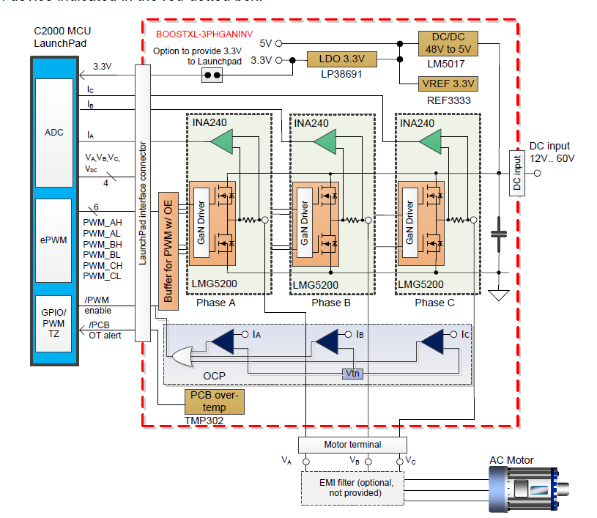
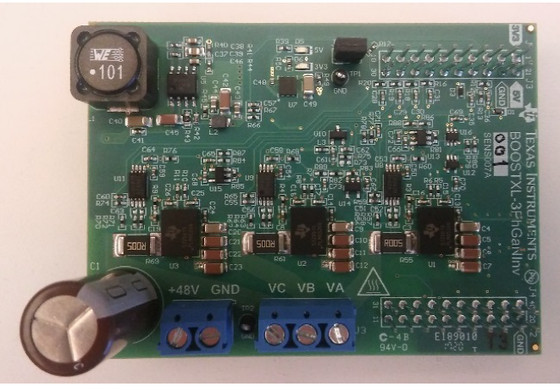
Experimental works
GaN transistor based VSI (BOOSTXL-3PHGANINV) ti design

Slide 31
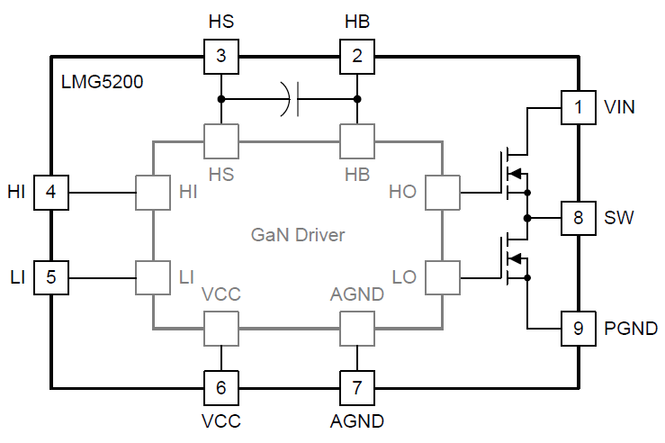
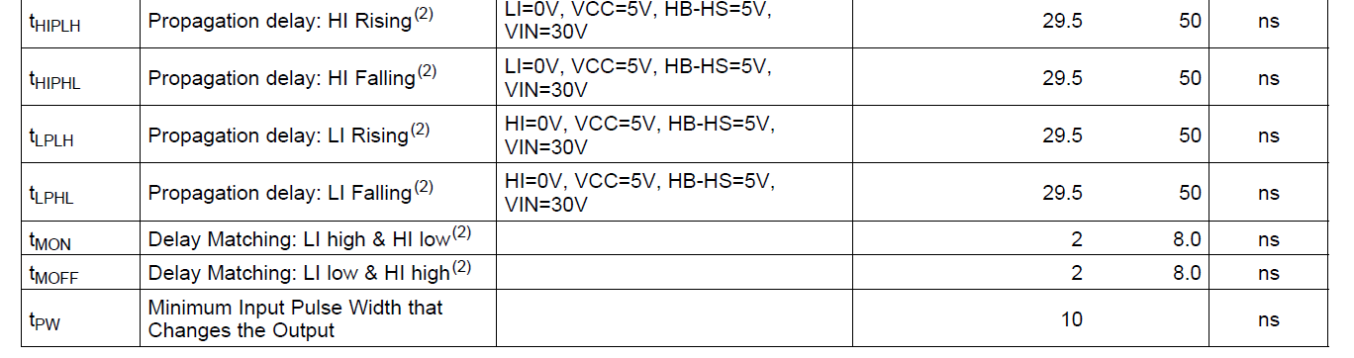
Experimental works
LMG5200 integrated GaN HEMT and Driver half bridge
LMG5200 GaN half-bridge features
Integrated 15-mΩ GaN FETs and Driver
80-V Continuous, 100-V Pulsed Voltage Rating
Very Low Common Source Inductance
Gate Driver Capable of Up to 10 MHz Switching
Excellent Propagation Delay (29.5 ns Typical) and Matching (2 ns Typical)

Slide 32
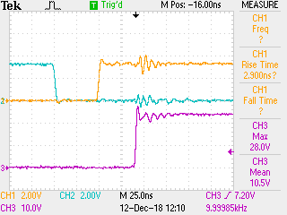
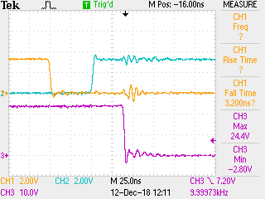
Experimental works
Switching characteristics of the LMG5200 is given following figures. Dead-time is settled to 50ns in this experiment
For this example dead-time 50ns is the 0.05% of the switching period when fsw 10kHz and it is 0.5% when fsw 100kHz
blue input pwm_LO, orange input pwm_HI, purple SW of the LMG5200 GaN half bridge @10kHz fsw

Slide 33
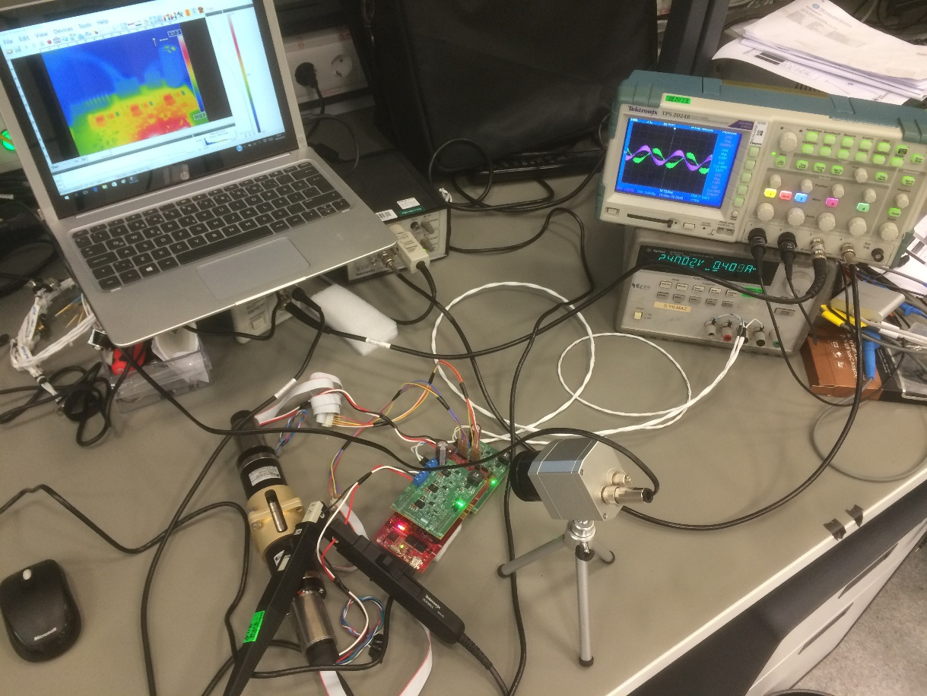
Experimental works
for this application following test setup is prepared, one motor is the driver motor and the other is the load motor

Slide 34
Experimental works
Texas Instruments' Software Frequency Response Analyzer (SFRA) library is used for frequency response analysis of the open loop characteristics of the current id & iq closed loop system
effective switching frequency is doubled by double sampling method
fast current loop FCL ti library is used for current control
target current control bandwidth for id and iq loop is configured as fsw/6

Slide 35
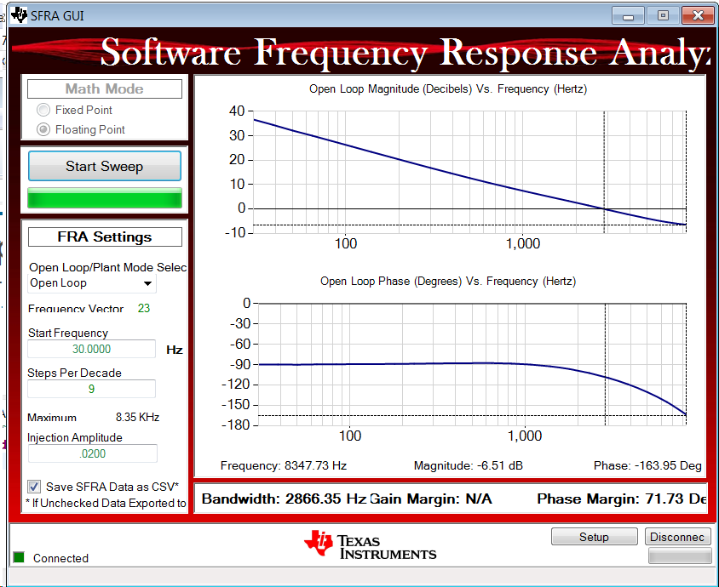
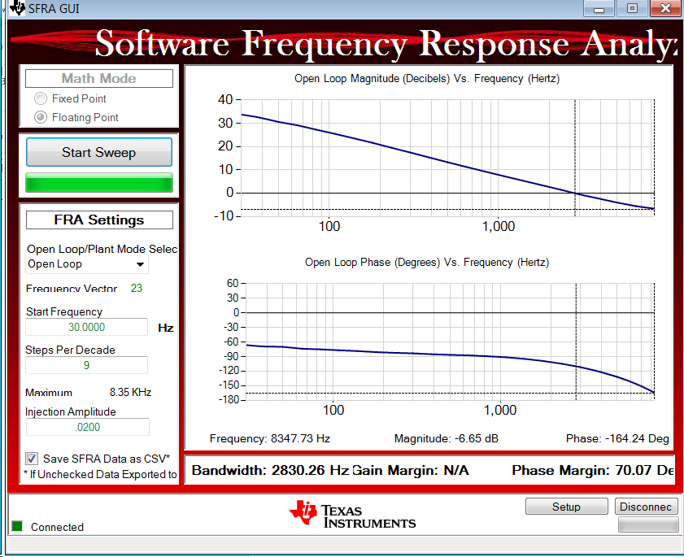
Experimental works
frequency response of the open loop characteristics of the current id closed loop system @20kHz fsw
frequency response of the open loop characteristics of the current iq closed loop system @20kHz fsw

Slide 36
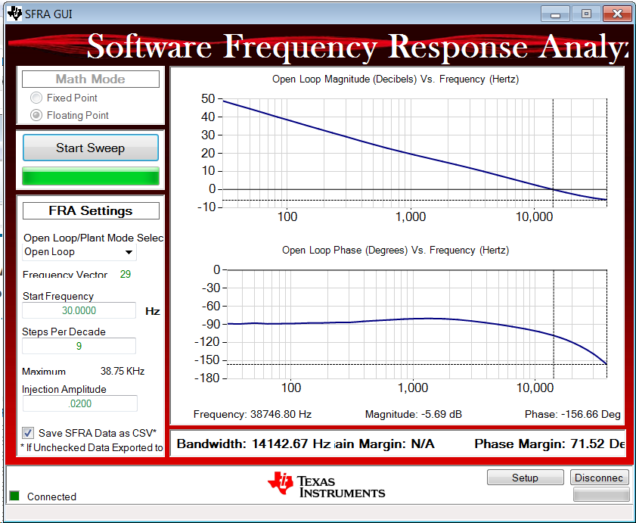
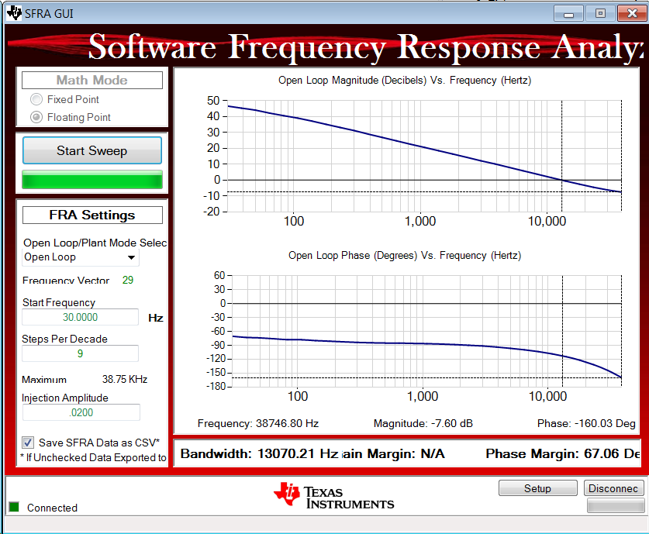
Experimental works
frequency response of the open loop characteristics of the current id closed loop system @100kHz fsw
frequency response of the open loop characteristics of the current iq closed loop system @100kHz fsw

Slide 37
Future plan
Low inductance motors which are designed by removing iron teeth from a motor stator or making an air core actuator allows
smooth motion
high efficiency
fast response
detent free
good heat dissipation
high overload capacity
good Kt linearity
But on the other hand, low inductance values can lead to control loop instabilities, inaccuracies in current readings, increased power losses and other problems
So to cope with these problems current control bandwidth will be high, which it turns switching frequency should also be high

Slide 38
Future plan
GaN transistor based VSI is planning to design to get high current control bandwidth
Since the current loop is the inner most of the control loop, it enables the outer speed and position loops to be faster for servo motor drive
This high performance servo motor drive can be used applications such as pedestal, robot arm, optic stabilizer, CNC machines, active vibration canceller etc.
It will be also used to drive low inductance motors

Slide 39
Future plan
While designing the layout of the GaN based VSI, some software tools are planning to use to determine layout parasitic inductances of the PCB layout
Wide band gap devices enable a higher switching frequency and higher edge speeds
For this reason simulating these parasitic inductances while designing layout, gets more important issues

Slide 40
future plan
 | 2019
 | January | February | March | April | May | June
submit the results of the research work to a conference | x
GaN and gate driver selection, simulation of three phase VSI inverter | x | x
three phase VSI inverter layout simulation |  | x | x
submit the results of the research work to a conference |  |  | x
three phase VSI inverter pcb manufacturing |  |  | x | x
three phase VSI inverter compenents mounting |  |  |  | x | x
three phase VSI inverter functional tests |  |  |  |  | x | x
submit the results of the research work to a journal |  |  |  |  |  | x

Slide 41
future plan
candidate conferences
2019 IEEE 13th International Conference on Compatibility, Power Electronics and Power Engineering (CPE-POWERENG)
Abstract Submission Deadline: 7th of January 2019, Conference Date: 23-25 April 2019
2019 10th International Conference on Power Electronics and ECCE Asia (ICPE 2019 - ECCE Asia), Korea (South)
Abstract Submission Deadline: 13 Oct 2018, Conference Date: 27-31 May 2019
2019 International Aegean Conference on Electrical Machines and Power Electronics (ACEMP) & 2019 International Conference on Optimization of Electrical and Electronic Equipment (OPTIM), Turkey
Draft paper submission deadline：2019-04-01, Conference Date: 27-29 August 2019

Slide 42
future plan
candidate journals
Power Electronics Magazine, IEEE
Power Electronics, IEEE Transactions on
Industrial Electronics Magazine, IEEE
Industry Applications, IEEE Transactions on
Industry Applications Magazine, IEEE
IEEE Journal of Emerging and Selected Topics in Power Electronics
IEEE Transactions on Education

Slide 43
thank you

